Slide 1
Hotel Reviews: NLP & Sentiment Analysis
Data 608
Group 5
Jannatul Naeema
Deyvis Dalman
Devanshi Patel
Utsav Agrawal

Slide 2
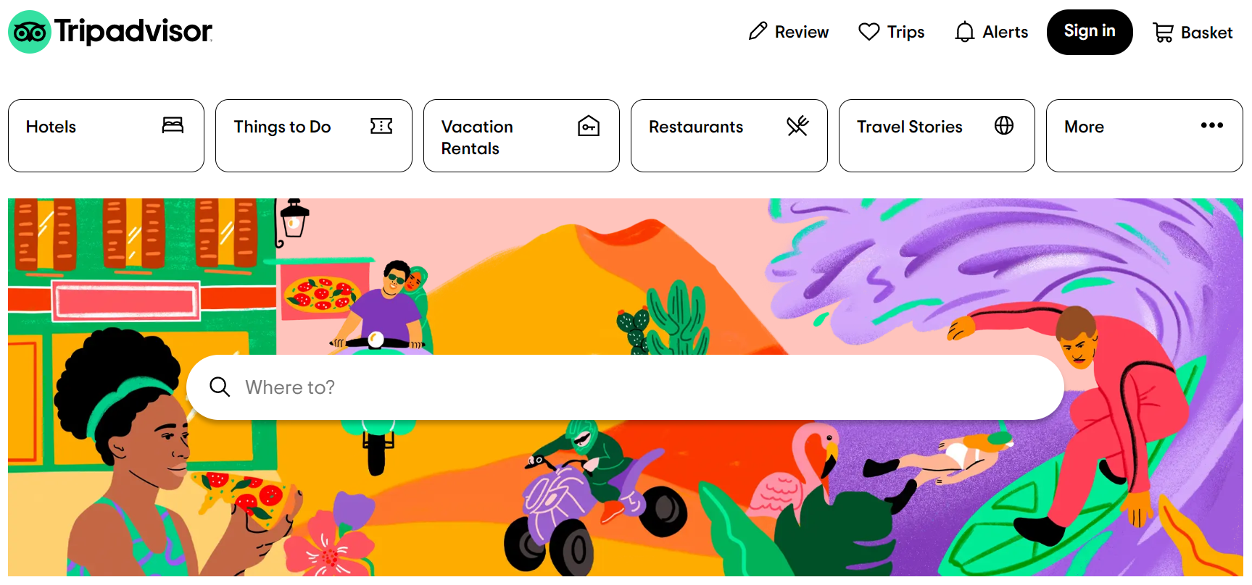
Introduction
Goal:
Learn & Deploy NLP techniques
Analyze and extract valuable insights
Source:
Hotel reviews: Tips advisor, Booking.com
Use:
Identify important keywords and areas of improvement
Understand customer preferences
Acquire a competitive advantage in the hospitality industry

Slide 3
Datasets
TripAdvisor:
Team used a dataset on hotel reviews which was scraped from TripAdvisor.
The dataset contains ~ 259k reviews for 1625 different hotels.
It features hotel reviews for 10 different cities. The team chose to do only 5 of these cities: Dubia, Shanghai, Delhi, NYC & London.
Booking.com:
Found on kaggle, features 515k reviews from luxury hotels in Europe.
Dataset was scraped from booking.com, it features 17 fields.

Slide 4
Learning Objectives
Deyvis Dalman:
Learned Text Classification on each review to classify the topic of each review. Possible classifications may be cleanliness, food, service, or amenities for a hotel
Break down for each classification may then be done to identify areas of strength and weaknesses for a hotel
Both rule-based text classification and machine learning text classification will be explored, if possible, in the time frame of the project.
Jannatul Naeema:
Learned the terminology and how to use tokenizer, autotokenizer, pipeline, tf-idf, pretrained model e.g. Vader and Bert model for sentiment analysis; also using GPU/TPU is a new learning experience for me.

Slide 5
Learning Objectives
Devanshi Patel:
Data wrangling process by converting files to CSV and separating review text and date. Moreover
Learning NLP techniques for keyword extraction techniques (removing stopwords, Stemming, removing irrelevant words not related to hotel) on review of a dataset
Once the words have been extracted an overall wordcloud for each city consisting of all hotels will be visualized.
Webapp deployment on Amazon AWS
Utsav Agrawal:
Perform sentiment analysis specifically on two-scale points (positive/negative)
NLP techniques using NLTK and VADER and try to do transfer learning with BERT
Webapp deployment on Amazon AWS

Slide 6
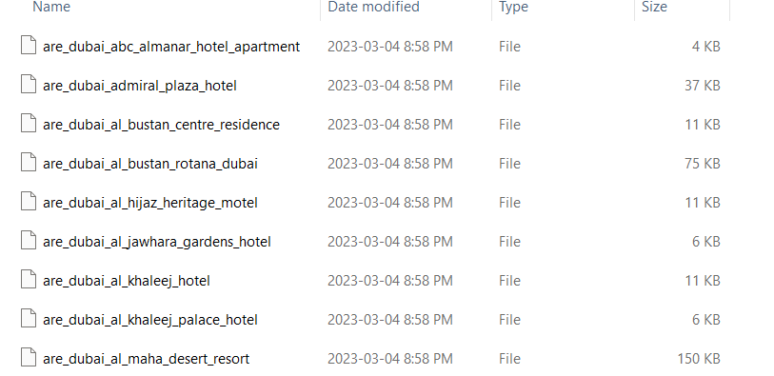
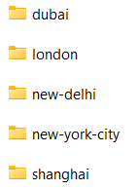
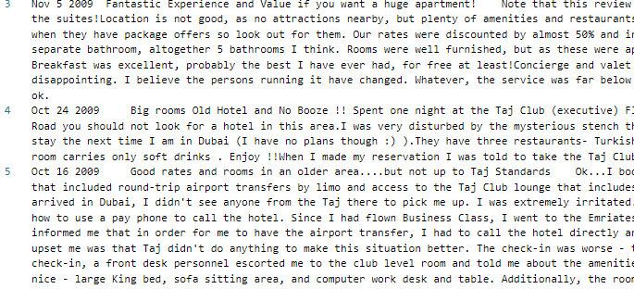
Data Preprocessing for NLP (Automated File conversion)
1) 5 cities
2) Files in each city
Read 1625 hotel files over 5 cities line by line
Separate out Date and text from each line
Convert individual files to CSV's. Total: All hotel for each city – 5 CSV's + 1625 CSV's of individual hotels
3) Reviews in each file

Slide 7
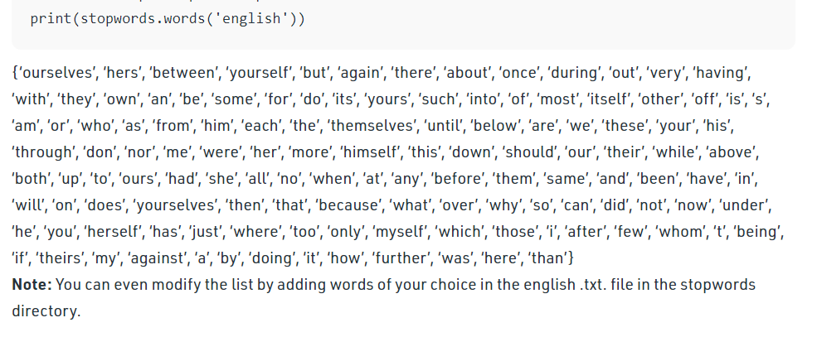
Data Preprocessing for NLP (Techniques)
Tokenization (Separate each word from sentence)
My ability to do exercise has increased
['My','ability','to','do','exercise','has','increased']
Lemmatization (Meaningful root form)
Caring, members
Care, member
Stemming (root form)
Caring, because
Car, becaus
Stopwords (commonly used word)

Slide 8
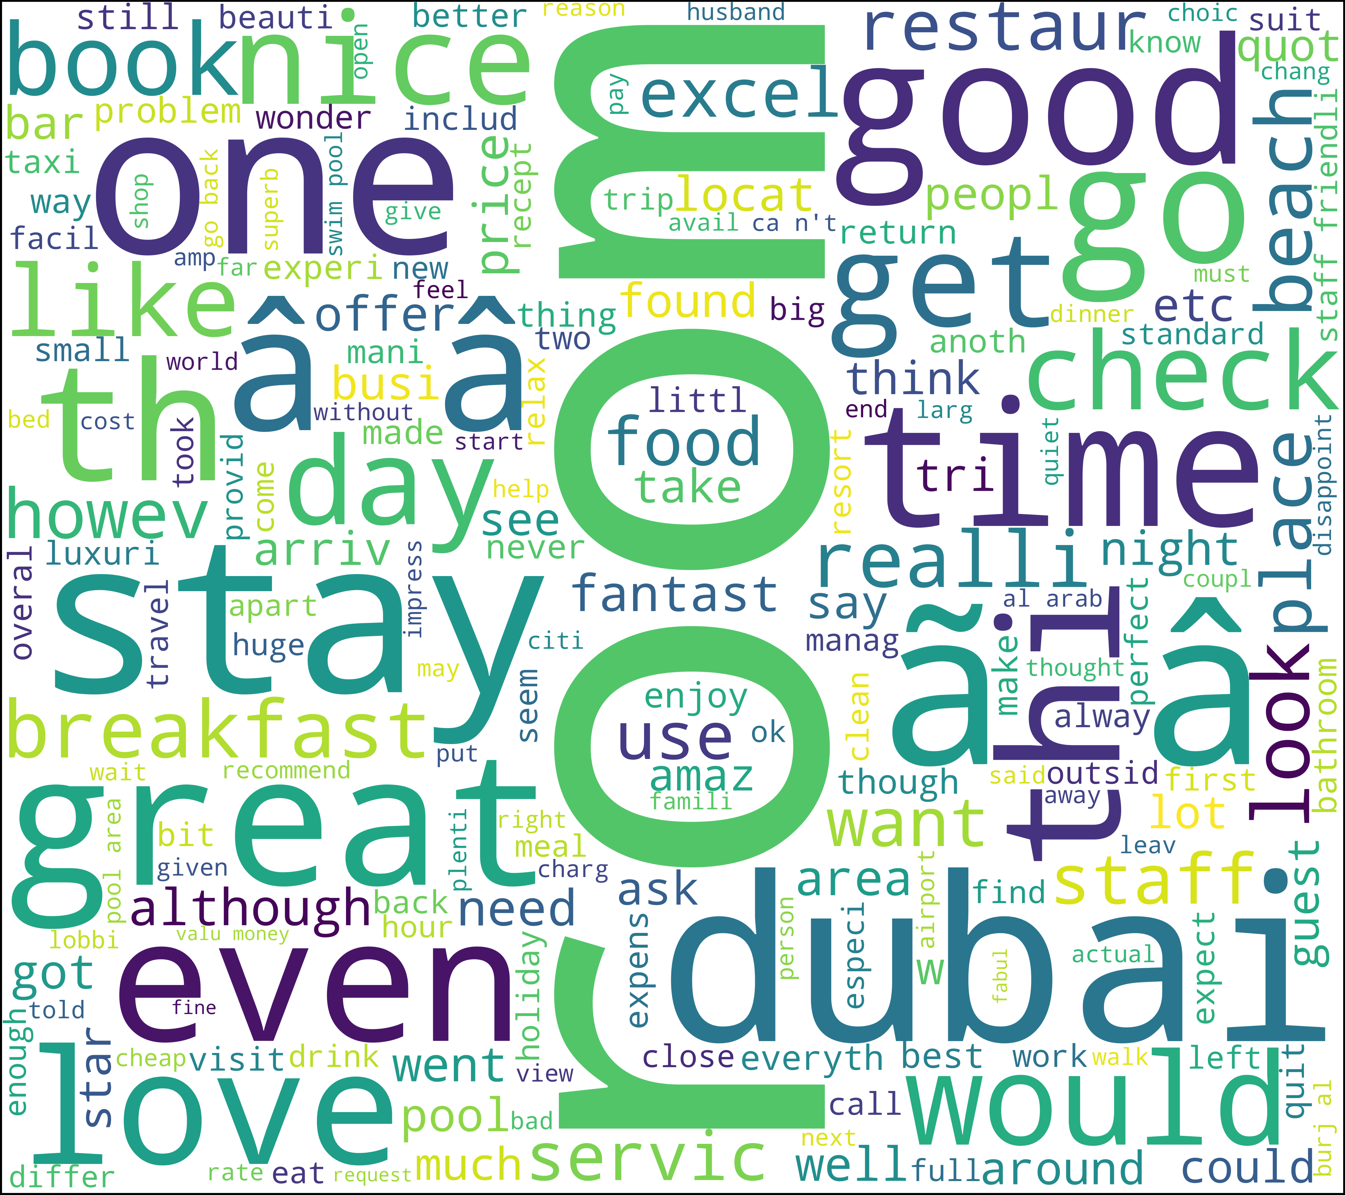
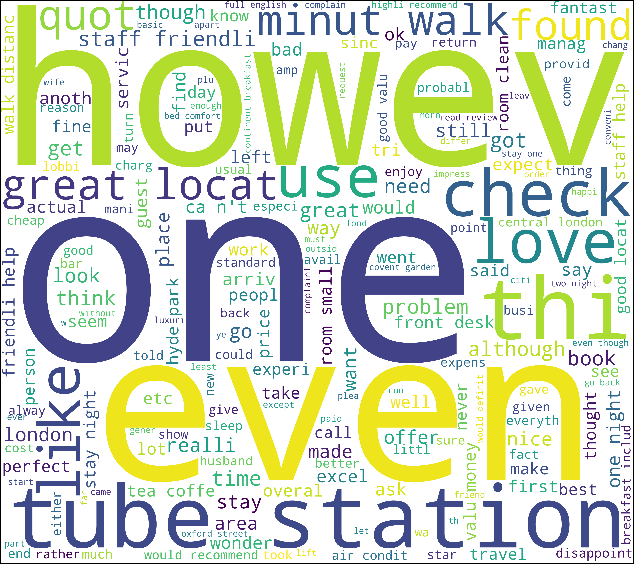
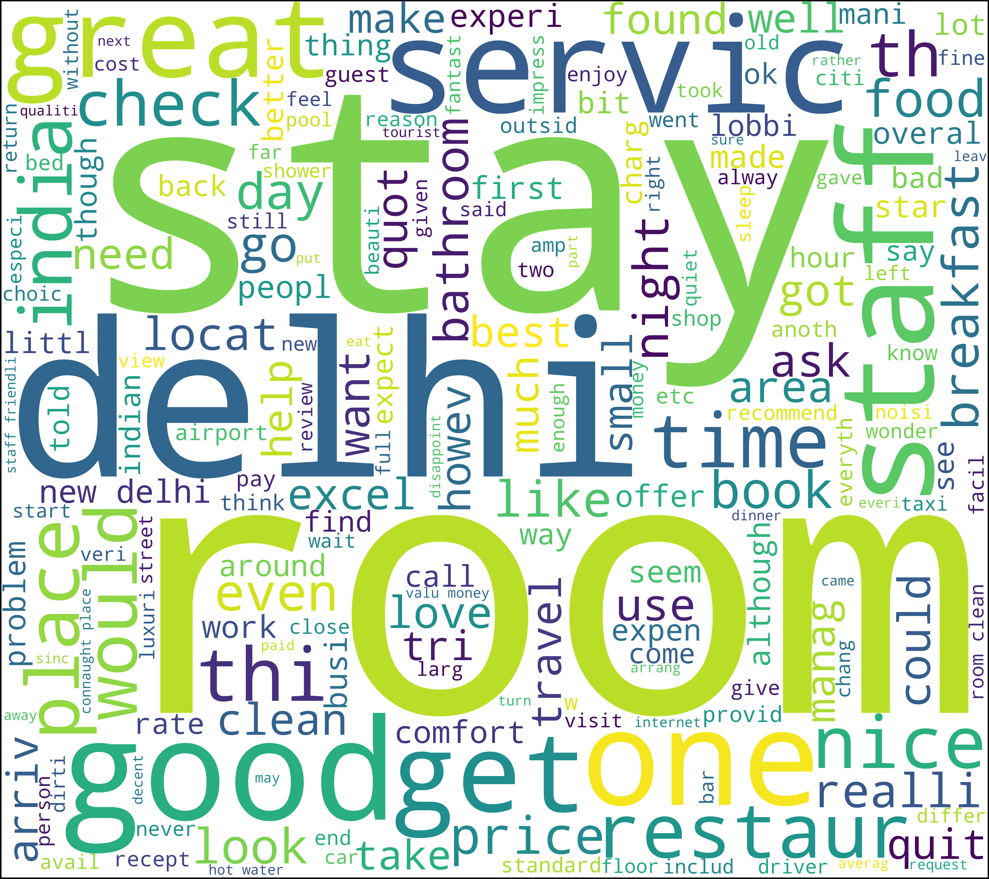
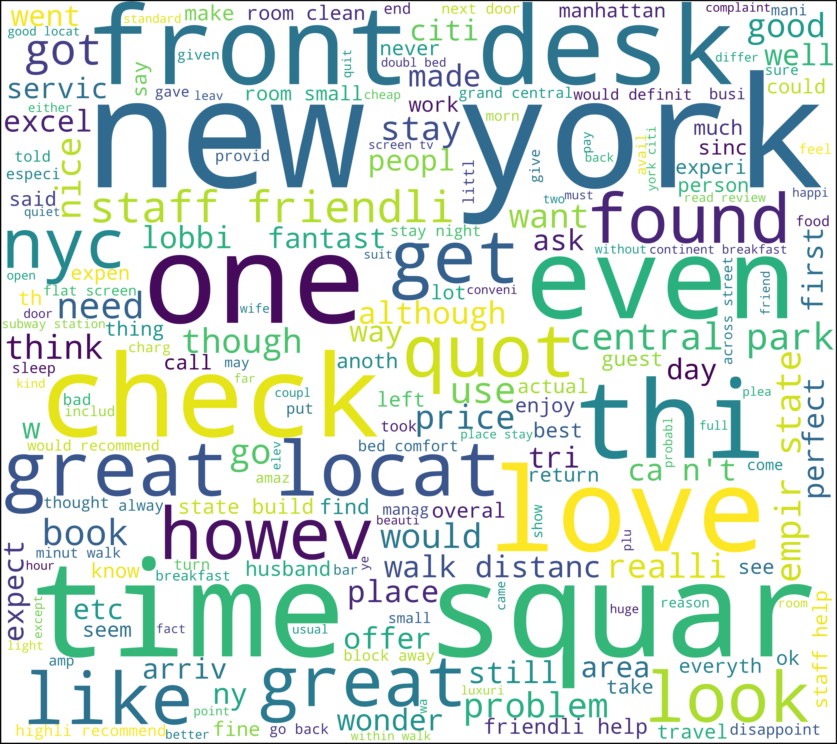
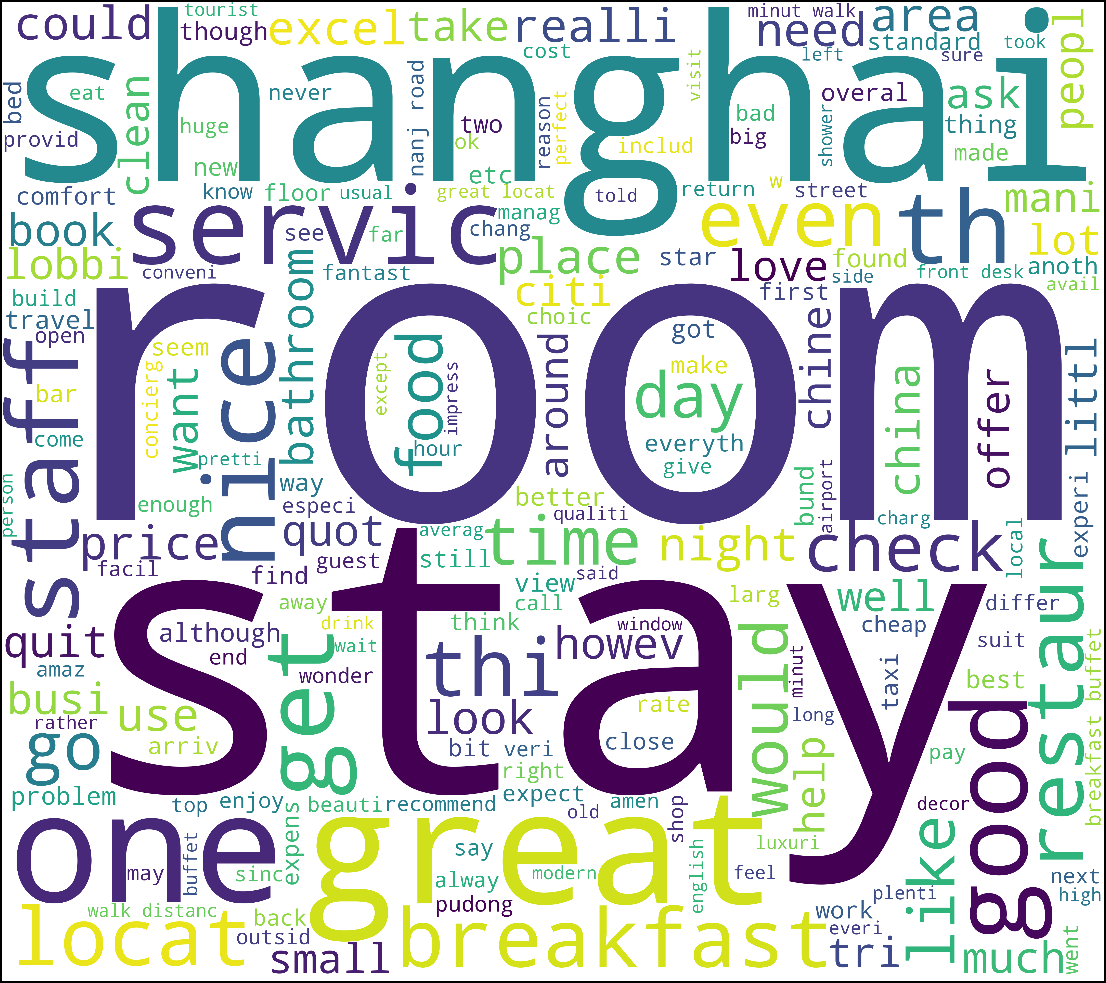
Wordcloud after NLP preprocessing (5 cities)

Slide 9
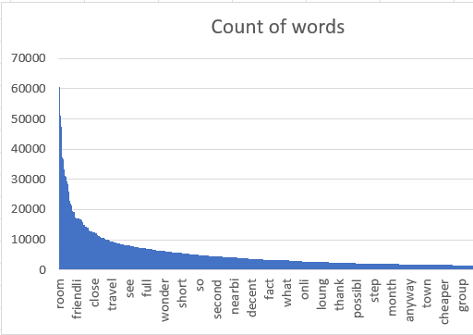
Bag of words
Technique used in NLP where a count of total occurrence of most frequent words are kept.
The diagram below shows bag of words for Dubai city from all hotels in that city.

Slide 10
TF-IDF: Term Frequency-Inverse Document Frequency
TF
Term Frequency
Frequency of a word appears in a document
IDF
Inverse Document Frequency
Measures how rare or common a term is across all documents in the collection
TF-IDF
Identify important words and phrases in a corpus
Measure the frequency and rarity of terms

Slide 11
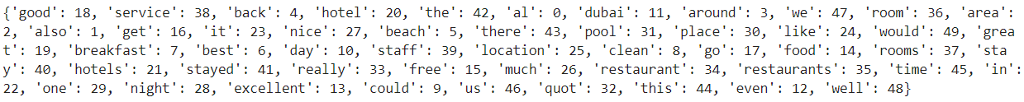
TF-IDF for Five Different Cities
Delhi
Dubai
London
NYC
Shanghai

Slide 12
BERT from Hugging Face: Sentiment Analysis
Bert
Developed by Google
Pre-trained deep learning model
Used for natural language processing (NLP) tasks
Hugging Face
Platform
Create and share pre-trained NLP models
Hugging Face Transformers library contains pre-trained BERT models
The models are used for fine-tuned for various NLP tasks.
NLP: Text classification, Sentiment analysis
Bidirectional Encoder Representations from Transformers
Teams LSTM model and use of pretrained BERT model are still training in Google collab ( for last 10 hrs….)

Slide 13
Text Classification
Words were chosen after viewing the 500 most common words.
Food: restaurant, restaurants, pasta, food, dinner, lunch, breakfast, menu, burger, pizza, tea, coffee, brunch, snack, snacks.
Service: check-in, staff, friendly, reception, kind.
Cleanliness: dirty, clean, hygiene, tidy, washed, spotless, stained.
Price: cost, cheap, expensive, costly, overpriced, value.
Location: view, location, airport, ocean, skyline.

Slide 14
Text Classification
Results from Model: Evaluation Accuracy
City | Food | Service | Cleanliness | Price | Location
Delhi | 89.43% | 92.17% | 92.78% | 86.38% | 89.63%
London | 98.09% | 97.96% | 98.89% | 98.59% | 98.99%
New York City | 97.22% | 97.13% | 98.49% | 98.01% | 98.25%
Dubai | 89.43% | 92.17% | 92.78% | 86.38% | 89.63%
Shanghai | 88.79% | 91.11% | 89.60% | 84.34% | 90.54%

Slide 15

Sentiment Analysis
NLTK Library
VADER Sentiment Analysis
Team used the inbuilt Python library NLTK to carry out sentiment analysis on the Reviews for the hotels
Team realized that original dataset doesnot have reviewers rating for each review
Team used another dataset of hotel reviews to train their model for sentiment analysis
Score provided by the reviewers to decide on positive, negative or neutral sentiment for the review
Vader sentiment analysis was used to generate Negative score, Positive Score and Compound score for each review
Gaussian Naïve bias classifier was used to train classification model for Positive, Negative and Neutral sentiments with for each review in test set with 82% accuracy

Slide 16
Sentiment Analysis
NLTK Library
VADER Sentiment Analysis
Team then used these scores generated by Vader to train a model to predict average scores for each hotel.
Randomforest Regressor & Gradient Boost Regressor were used with RMSE of 0.56 and 0.53 on test dataset
Team then used this trained model of average score on the original dataset. RMSE achieved was 0.6 on the original dataset

Slide 17
Presentation 2nd part

Slide 18
Sentimental analysis of a review(Amazon AWS) & Hotel prediction based on question asked by user
LIVE DEMO (In Class)

Slide 19
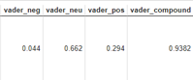
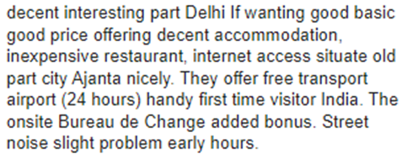
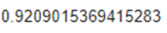
Vader and Bert Sentiment: Scores produced by Bert and Vader differ from each other for same review
Finally got something out of our BERT Model run

Slide 20
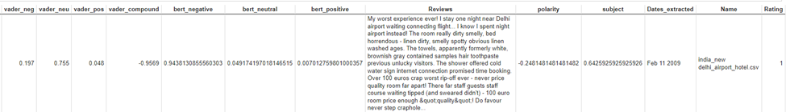
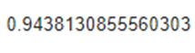
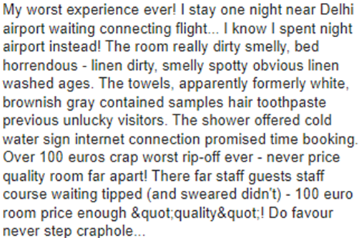
Vader and Bert Sentiment: Scores produced by Bert and Vader differ from each other for same review
Score provided by Bert Model were more accurate compared to VADER when (intuitively). As our BERT model run took too long we cannot run it on our other dataset with Reviewer scores

Slide 21
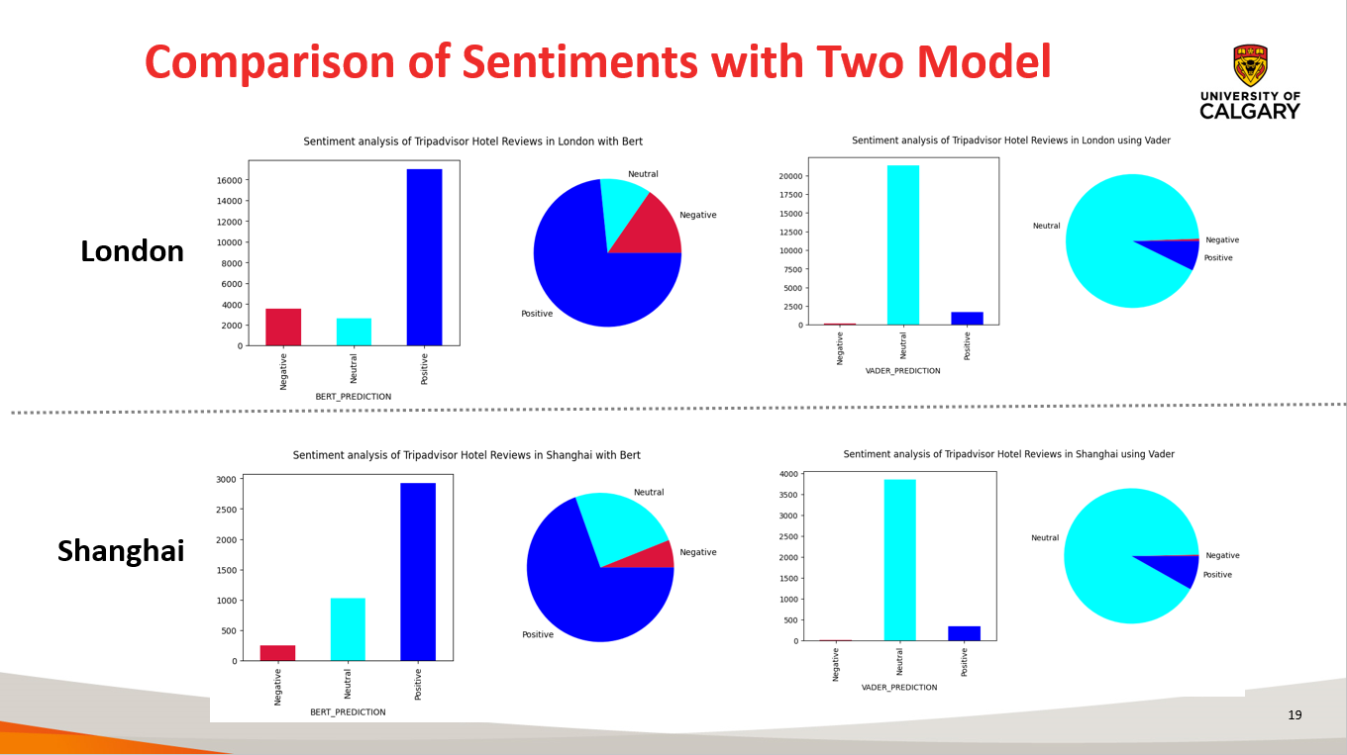

Slide 22
Question-1
Jasmeen Sekhon: Did you find any differences in the overall sentiment of users in the different cities. I noticed the cities included in your analysis are located in different parts of the world, so I am just curious to know how the sentiments vary across the globe.
For the text classification portion was there any particular reason for choosing logistic regression and are you considering applying different classification techniques to see how the results differ?
Answer:
Multinomial Logistic Regression was used for text classification because it was the approach that familiar, reliable and ease of use. In the future we may pair it with a nltk library for n-gram classification.

Slide 23


Sentiments at Different Cities
 | Dubai | Delhi | Shanghai | London
Positive | 84.24% | 66.79% | 69.47% | 73.37%
Negative | 7.36% | 15.15% | 5.98% | 11.28%

Slide 24
Question-2
Kane Smith: I would be very interested in an update regarding how it performed and if there were any issues you ran into. How did it compare to the VADER algorithm? Did you find any ways to increase the speed of training the model?
Answer: Tensorflow terminates the code if it finds > 256 tokens in a sentence. Thus, I have to perform exception handling. To train the model faster it needed GPU and TPU to reduce runtime thus I went to paid version of collab for training part.

Slide 25
Question-3
Yi-Chi Chang: Are the reviews translated from other languages to English for data from Shanghai or other cities where the majority spoken language is not English? Or do you keep English reviews only?
Answer:
In our dataset all reviews are in English, it might be translated, but we got all the reviews in English. I agree with you, translating sometimes takes away the context.

Slide 26
Question-4
Ibtassam Rasheed: I have a question about 'Bag of words'. When counting frequencies of a certain word, are you first finding unique words in each review and then adding them to a bag of words or is it a cumulative count across reviews?
Answer:
Thank you for taking your time to review our presentation. To answer your question, I had the same thing in mind while coding and thus for each review after tokenizing into individual words I was adding words into list only if already not present in list, this makes sure there that are no duplicates from same review.

Slide 27
Question-5
Isaac Tong: I just have one comment in the preprocessing step and I would like to learn more about it. Can you explain further on how you automated the process for data pre-preocessing? Did you use any technology in the cloud and what were the file format in the raw form?
Answer:
We didn't use any cloud platform for preprocessing.
The file format for our data was "All File format" containing text and date similar to any notepad file which was new to us a team.
I made 1-2 python scripts where to read this file I used open("filename",'r') without any extension and read the file line by line and append it to dictionary until newline. Passing the dictionary to dataframes which finally converts to CSV's. Further, the CSV's were used for tokenization, lemmtization and stemming process in same script.

Slide 28
Question-6
Farid Ullah: What was the file format for these files initially. Were they .txt files? Why you converted the files to csv's, any particular reason? I know you wanted to separate the data and text. Can these things be done by using some sort of regular expressions.
Answer:
1) The file format was "ALL FILE TYPES" which is not txt if we want it in txt we have to convert the extension to txt.
2)The decision to convert the file format to CSV was taken because at the end we wanted to work on Model building which works well when your file is in CSV's rather than txt for conversion into dataframes. -Also one instance where there were individual hotels in each city, lets say dubai has 120 hotels and each hotel having 200-250 reviews we wanted a column which specifies hotel name and reviews to that hotel for training our model to predict hotel. In this case the CSV's is easy to operate by adding a column with data from a dataframe which can be complicated in txt's. If a file is in txt every time a team member wants to make a model they have to spend time converting them to a Model building format thus if a common format is used at initial step then no further code for conversion is required. For separation of data and text, I used regular expression as there was a common pattern thus it was best approach.

Slide 29
Question-7
Prashant Mittal: What do you think are the benefits of removing these stop words, and how might it impact the accuracy of the sentiment analysis model? Are there any potential drawbacks to removing stop words that should be considered?
Answer:
On removing stopwords, dataset size decreases and the time to train the model also decreases. Removing stopwords can potentially help improve the performance as there are fewer and only meaningful tokens left.

Slide 30
References
Trip Advisor Review Dataset. Retrieved from: http://kavita-ganesan.com/entity-ranking-data/#.XQESU9NKgWq on 5th March 2023.
What is natural language processing (NLP). Retrieved from: https://www.ibm.com/topics/natural-language-processing on 5th March 2023.
Natural Language Processing (NLP),What it is and why it matters. Retrieved from: https://www.sas.com/en_ca/insights/analytics/what-is-natural-language-processing-nlp.html on 5th March 2023.
Generating Word Cloud in Python. Retrieved from: https://www.geeksforgeeks.org/generating-word-cloud-python/ on 5th March 2023.
F. Heimerl, S. Lohmann, S. Lange and T. Ertl, "Word Cloud Explorer: Text Analytics Based on Word Clouds," 2014 47th Hawaii International Conference on System Sciences, Waikoloa, HI, USA, 2014, pp. 1833-1842, doi: 10.1109/HICSS.2014.231. Retreived from: https://ieeexplore.ieee.org/document/6758829 on 5th March 2023.
Trip advisor Review Dataset on Kaggle. Retrieved from: https://www.kaggle.com/datasets/jiashenliu/515k-hotel-reviews-data-in-europe on 19th March 2023.
TF-IDF [Tutorial] in Python. Retrieved from: https://www.kaggle.com/code/paulrohan2020/tf-idf-tutorial on 20th March 2023.
Sklearn feature extraction text and TfidfVectorizer. Retrieved from: https://scikit-learn.org/stable/modules/generated/sklearn.feature_extraction.text.TfidfVectorizer.html on 20th March 2023.
Hugging face pretrained models. Retrieved from: https://huggingface.co/models on 20th March 2023.
Hugging face transformer bert models. Retrieved from: https://huggingface.co/docs/transformers/model_doc/bert#transformers.BertModel on 20th March 2023.

Slide 31
Thank You

